Slide 1





Kartikeya Agnihotri
Payments Overview
Role: Product Solution Engineering Intern
Dept: eMobility

Slide 2
Index
SEW Payment’s Platform
AiElectron Base App
AiElectron CX Portal
Smart CX
AiElectron BX
Payment Architecture

Slide 3
iPay Smart - SEW Payment’s Platform
iPaySmart is a digital payment platform used for handling billing, payments, and transactions within apps or systems . It uses multiple channels like web , app , text to pay, IVR. It ensures compliance with security standards such as PCI-DSS and NACHA.
PCI-DSS - stands for Payment Card Industry Data Security Standard.
It is a security standard that ensures companies handle credit and debit card data safely.
NACHA stands for National Automated Clearing House Association.
NACHA compliance means following rules for ACH (bank-to-bank transfer done electronically) payments, including collecting and storing customer consent before processing the transaction.

Slide 4
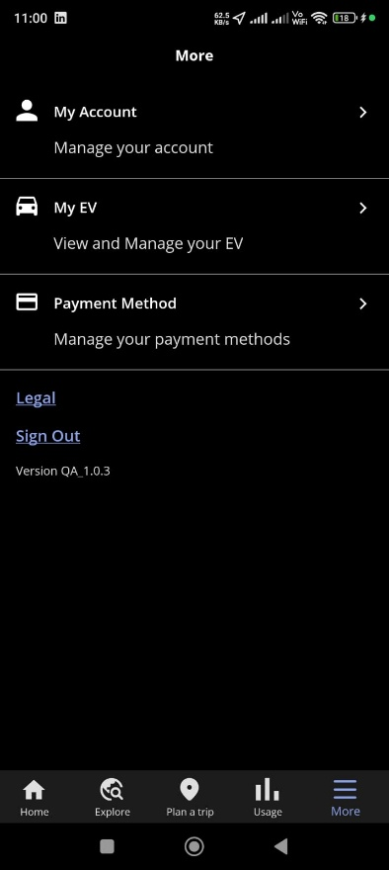
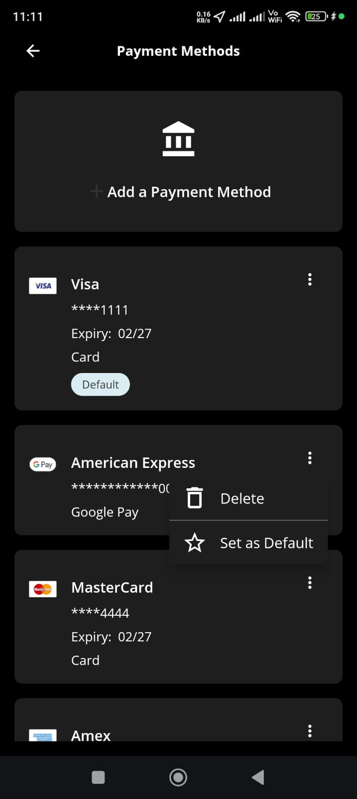
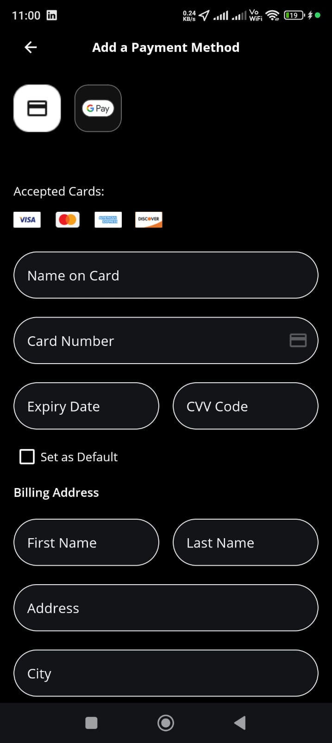
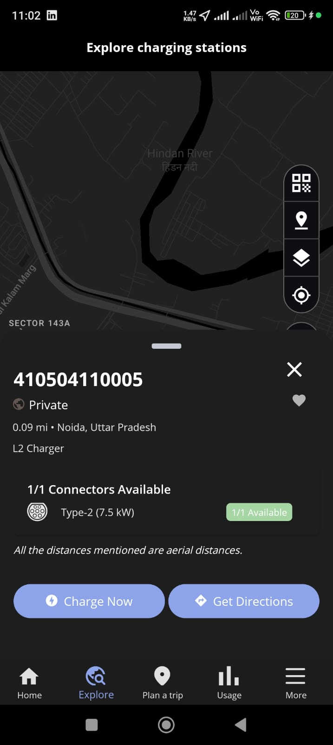
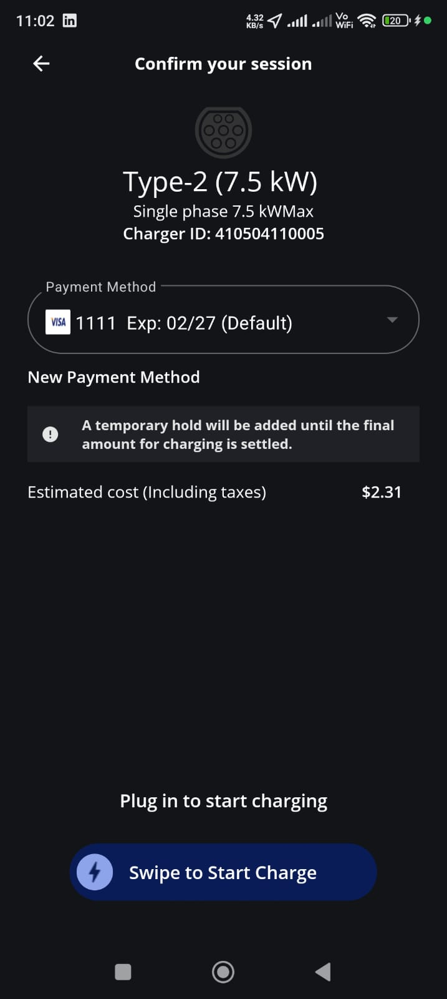
Payment Flow – AiElectron App

Slide 5
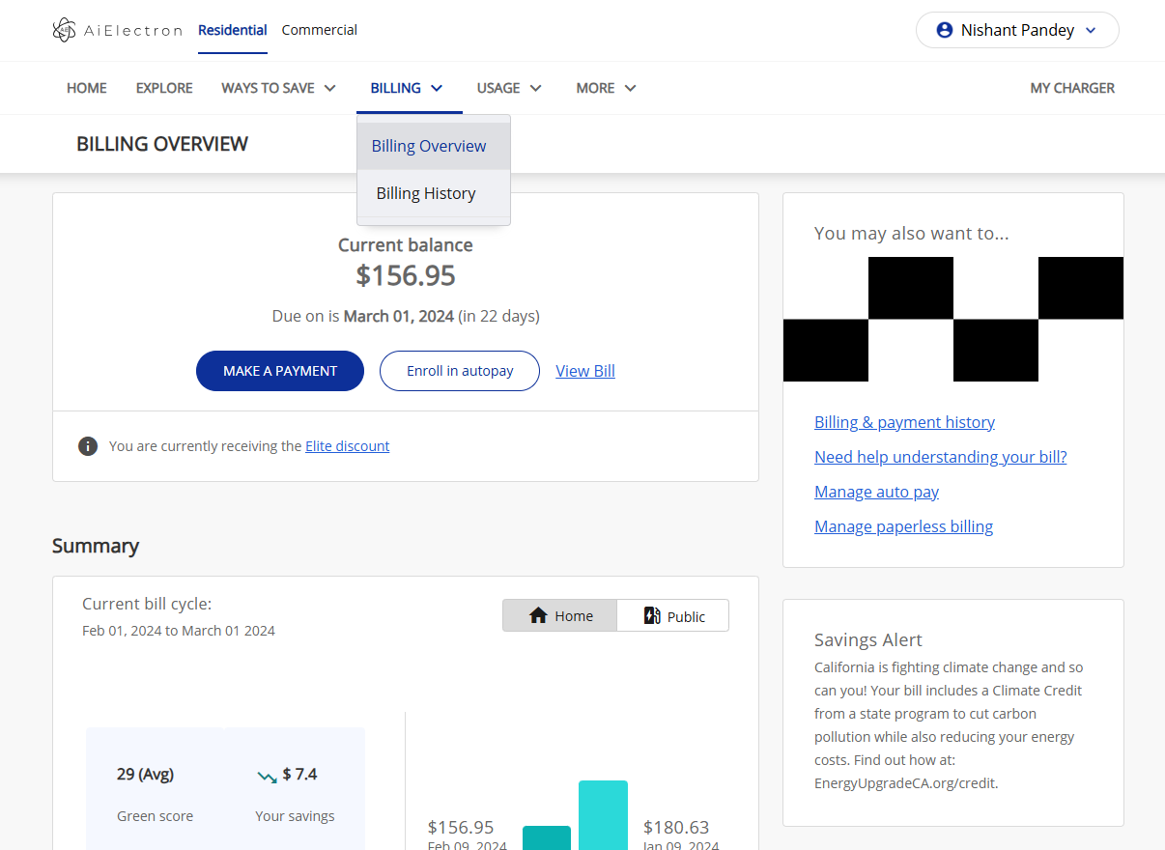
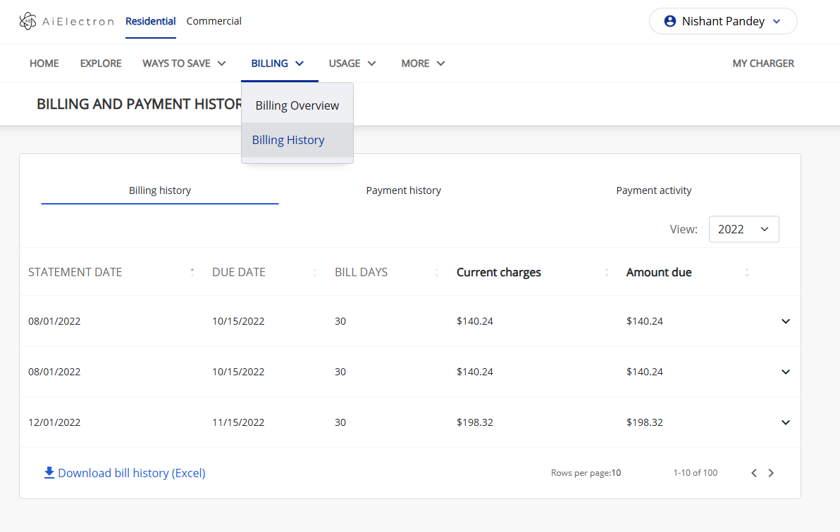
Payment Flow – AiElectron CX Portal

Slide 6
Smart CX - Payments
Post login
Payment Locations - This feature displays the addresses of various payment locations where user can physically make bill payments.
Budget Billing - is a feature that helps users pay a fixed estimated amount every month instead of different bill amounts each month
Jan - $120 Feb - $90 Mar - $150
Total yearly bill: $1440
Monthly average budget bill:
$1440 ÷ 12 = $120 per month Eligibility - Account has at least 12 months of billing history

Slide 7
Smart CX - Payments
Auto Payment - is a feature where the system automatically pays the user's bill before the due date using the user's saved payment method.
So the user does not need to manually pay the bill every month.
Current Billing - The Current Bill screen provides the user the ability to view a detailed breakup of due Bill amount under ‘Bill Summary’ for the current bill period and the future scheduled payments. Make Payment feature is also available in this screen.

Slide 8
Smart CX - Payments
Text to pay - Text to Pay allows a user to pay their bill using SMS
The user first enrolls by providing:
Phone number
Payment method (card/bank) (Fig)
Payment Arrangements (Fig)
Payment Extension - If the eligible user wants to extend the due date for the outstanding bill the user can click on request extension button and select the configured extension date
Payment Installment - : If the eligible user wants to opt in for installment plan the user can click on Request Installment Plan button and user will be able to pay bill between two to six equal installments along with the current bill amount.

Slide 9
Smart CX - Payments
Payment Information - the section where users add, manage, and store payment methods to pay their bills
Billing Queries - This module allows user to raise/send their queries to the Utility company.
Billing and Payment History - The Billing & Payment History page allows users to view their past bills and payment transactions, including bill details, due amounts, and payment records within a selected date range.
Bill Date - The date when the bill is generated.
Due Date - The last date to pay the bill without penalty.
Previous Balance - Amount left unpaid from your last bill.
Current Charges - Charges for this month’s usage (electricity/water/gas).
Late Fees - Extra charge added if you did not pay on time.

Slide 10
Billing and Payments
Budget My Bill - user can set a spending limit for alerts. (Hidden Feature)
Example:
User decides:
Alert me if my usage goes above $100 this month
80$ - No Alert
105$ - Email Alert Send
This is not changing the bill — it’s only monitoring spending.
Eligibility – Users must have an AMI meter
AMI meter stands for Advanced Metering Infrastructure.
An AMI meter is a smart meter that can automatically send electricity/water/gas usage data to the utility company.

Slide 11
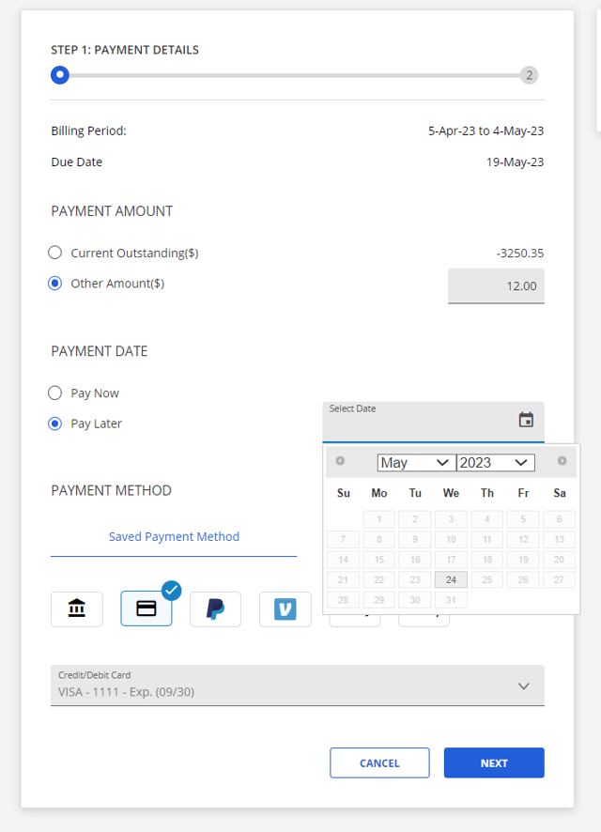
Billing and Payments
Schedule Payment - Scheduled Payment feature allows user to schedule a payment for future. The payment will be processed on the provided date using the provided payment method.

Slide 12
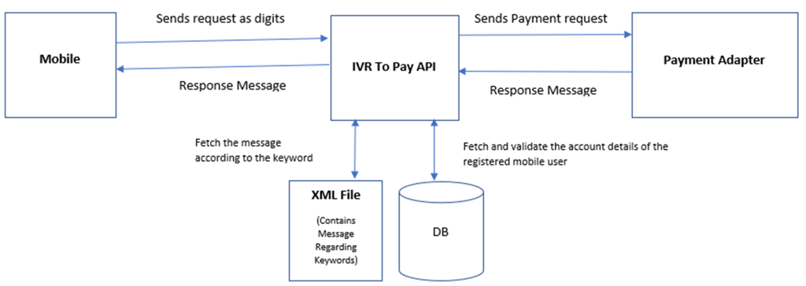
Billing and Payments
IVR – (Interactive voice response) lets customers pay their utility bill by calling a phone number and entering payment details through automated voice prompts.
IVR asks user to enter details like language type , account number , payment type etc.
Payment Adaptor - is a middleware component that connects the system to the payment gateway.

Slide 13
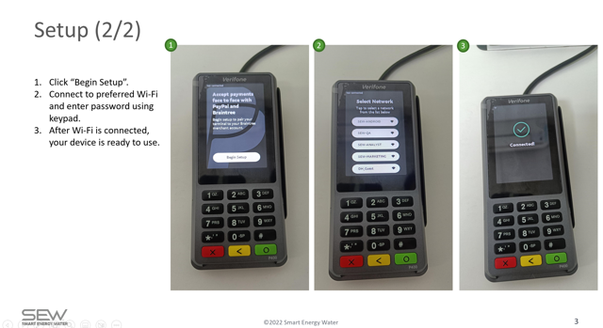
Billing and Payments
POS (Point of Sale) payments are payments made physically at the utility office using a POS machine (card swipe device).
Customer visits office → CSR opens account → Clicks Accept POS Payment → Enters account no. → Customer reviews → Card is swiped/tapped → POS processes payment → Success/Decline shown → System updates records & sends confirmation
CSR - CSR (Customer Support Representative) is the customer service agent of the utility company who helps customers with their accounts.

Slide 14
Billing and Payments
Payment Reconciliation - means verifying that all transactions recorded in the system match the funds deposited in the bank and the utility’s billing records. (CIS).
In simple terms:
Make sure money received = payments recorded in system.
Customers can pay through multiple channels web , app , IVR , POS , E-lockbox , Kiosk .
The accounting team retrieves reports, matches them with bank deposits and CIS records, investigates discrepancies, and finalizes reconciliation.
E-lockbox - Payments made from your bank account using your bank app or website
Kiosk - Payments made at self-service machines .
CIS - (Customer Information System) is a core utility system that stores essential account details, including account numbers, billing addresses, and contact information.

Slide 15
Billing and Payments
Void means cancelling a payment before it is settled.
The money has not yet been transferred to the merchant’s bank.
The transaction is cancelled immediately.
Example
Customer paid $100 by mistake and reports it immediately → CSR voids the transaction.
Important rule: Void can only be done before settlement.
Refund means returning money after the payment has already been settled.
The payment has already reached the merchant’s bank.
The system sends a request to return the money to the customer’s bank account/card.
Example
Customer paid $100, but later it was incorrect → CSR processes a refund.
Important rule: Refund can only be done after settlement.

Slide 16
Billing and Payments
Payment Return - occurs when a payment fails or is reversed by the bank or payment network.
Types of Payment Returns :
ECP Return happens when a bank payment (ACH) is rejected by the customer’s bank due to insufficient funds , invalid bank account etc.
Chargeback occurs when a customer disputes a card payment after it has been completed. Eg Customer contacts bank and says: “I didn’t do this payment”
Payment Decline(during card payments) happens when the bank rejects the payment immediately during processing due to insufficient funds , wrong cvv , expired card .
ACH = (Automated Clearing House) The bank network that processes the payments
ECP = Electronic Check Payment

Slide 17
Smart CX – Payments
Pre login
The Payment Center has six Tabs :
Pay Now – user clicks on Make Payment option after that user can verify account via Account Number and Zip Code . (fig)
Pay By Phone - Pay by Phone means paying your bill by calling a phone number instead of using the website.
Pay By Text means enrolling in Text to Pay and paying your bill using SMS (text messages) on your phone.

Slide 18
Prelogin
Auto Pay (Automatic Recurring Payments) means the bill is paid automatically every month without you doing anything.
Pay in Person means the user can go to a physical location and pay the bill there instead of paying online.
Pay by Cash feature means you can pay your bill using cash at a physical store, but first you generate a barcode from the website .

Slide 19
AiElectron BX
Payment Dashboard has a component that shows a single chart for all the various types of payments done to the utility. The fields covered in this chart: (fig)
Total Transactions
ACH
Credit/Debit Card
Failed Transaction
There are pie charts to demonstrate the breakups between the following:
Pre/Post Login
Payment Source- Web/Mobile
Credit/Debit Card/ACH
A bar graph for the following types of transactions out of the total transactions is also present : Refunded ,Pending ,Declined ,Error , Successful

Slide 20
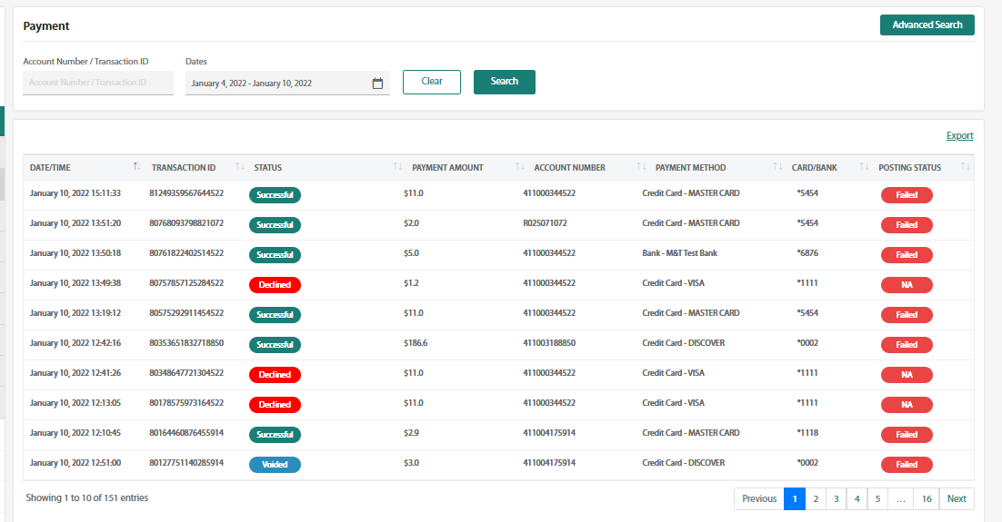
AiElectron BX
Payment Report is a dashboard in SmartBX (admin portal) where the utility team can view and manage all payment transactions. (fig)
It shows payments coming from all payment channels like web , app , text to pay , ivr , pos , external payments .
CSR/Admin can perform : Void and Refund .

Slide 21
AiElectron BX
Deposit Detail Report shows the funds deposited to the utility (merchant) each day and also includes refund transactions. (fig)
Deposit Summary This section shows aggregated deposit information, grouped by:
Payment Type
Payment Subtype (Card type)
Deposit Detail This section shows individual transaction records included in the deposit
Chargeback Report shows all credit card chargebacks initiated by customers.
ECP Return Report shows bank payment returns (ACH/ECP returns). (fig)

Slide 22
AiElectron BX
Payment status shows the current state of a transaction after it is processed by the payment gateway (Braintree or Chase).
Success - Payment was authorized and processed successfully.
Pending - Payment is still being processed by the gateway or bank.
Declined / Failed - Payment was rejected by the bank or gateway.
Voided - Payment was cancelled before settlement.
Refunded - Money was returned to the customer after settlement.
P-Refund – Partial Refund
ECP Return - Bank payment (ACH) was later rejected by the bank.
Chargeback / Dispute - Customer disputes a completed card transaction with the bank.
Error = Payment failed due to a technical/system issue .

Slide 23
AiElectron BX
Transfer Summary is a report that shows the money transferred (deposited) to the utility’s bank account each day. (fig)
Funds Transfer Instruction Number (FTI#) - A unique identifier for each utility . Contains information about Bank account
Funds Transfer Number - A unique number generated for each daily deposit.
Auto-Pay Enrollment - This feature shows all the accounts that have enrolled into Auto Pay in the selected period through the SCM platform.
Upcoming AutoPay - This feature shows all the upcoming Auto Pay payments to be processed for the next 7 days.
SCM – (Self-Care Module) the customer portal where users manage their utility account . Eg. Smart CX

Slide 24
AiElectron BX
Processed Autopay - CSP offers CSR’s the capability to view all processed Auto Pay Payments during the specified date range options.
Auto-Pay Enrollment shows which customers have signed up for automatic payments, while Processed AutoPay shows the actual payments that were made and whether they were successful, failed, or declined.
CSP – (Customer Service Portal) is the portal used by utility company staff (like CSR agents) to manage customer accounts. Eg Smart BX

Slide 25
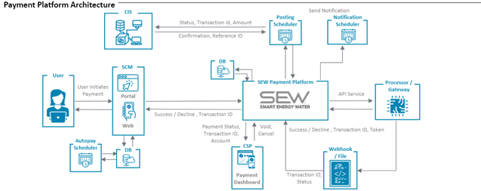
Payment Architecture

Slide 26
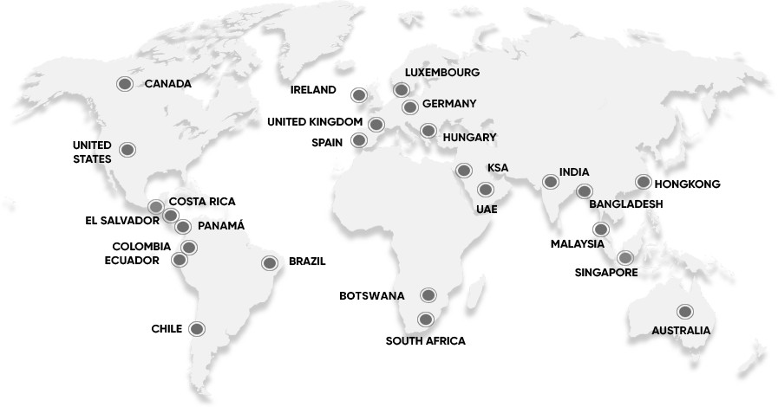
SEW Headquarters
15495 Sand Canyon Ave. Ste. 100, Irvine, CA 92618. info@SEW.ai
(949) 409-6833
© 2026 SEW.AI
9

